Slide 1
LIVER PATIENT ANALYSIS
-TEAM STARK

Slide 2

LIVER PATIENT ANALYSIS

Slide 3
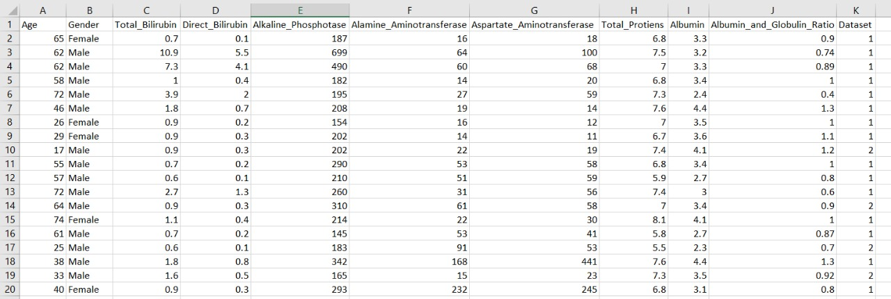
Dataset For Liver Patient Analysis

Slide 4


INTRODUCTION
PYTHON LANGUAGE
AI MACHINE LANGUAGE
Python is a very powerful programming language used for many different applications. Over time, the huge community around this open source language has created quite a few tools to efficiently work with Python.
AI Machine learning is the scientific study of algorithms and
Statistical models that computer systems use in order to perform a specific task effectively without using explicit instructions, relying on patterns and inference instead. It is seen as a subset of artificial intelligence
PYTHON
AI MACHINE LANGUAGE

Slide 5
DESIGN MODEL
DESIGN MODEL
TYPES OF MODEL USED
Gaussian Naïve Bayes
Model
RANDOM FOREST
MODEL
LOGISTIC REGRESSION

Slide 6
Random Forest Regression
A Random Forest is an ensemble technique capable of performing both regression and classification tasks with the use of multiple decision trees and a technique called Bootstrap Aggregation, commonly known as bagging.
Gaussian Naive Bayes Classifier
Naive Bayes is a classification algorithm for binary (two-class) and multi-class cclassification problems. The technique is easiest to understand when described using binary or categorical input values. The representation for naive Bayes is probabilities
Logistic Regression
Since the outcome is binary and we have a reasonable number of examples at our disposal compared to number of features, this approach seems suitable. At the core of this method is a logistic or sigmoid function that quantifies the difference between each prediction and its corresponding true value.

Slide 7
Random Forest Classifier:
It comes under the category of ensemble methods. It employs ‘bagging’ and ‘boosting’ methods to draw a random subset from the data, and train a Decision Tree on that (hence, the name Random Forest). In this case, we don’t know the relative importance of each feature while deciding the output, so a Random Forest can be successful as it will ensure training on different randomized subsets. Hyperparameters to be manipulated:
• n_estimators( number of trees in a forest)
• max_depth( maximum depth of one single tree)
• max_features( decides how many features are to be used)
• oob_score(decides whether to include out-of-bag or prediction error )
Accuracy scored:0.68

Slide 8
Gaussian Naive Bayes Classifier
Naive Bayes is a classification algorithm for binary (two-class) and multi-class classification problems. The technique is easiest to understand when described using binary or categorical input values. The representation for naive Bayes is probabilities.
A list of probabilities are stored to file for a learned naive Bayes model.
This includes:
Class Probabilities: The probabilities of each class in the training dataset.
Conditional Probabilities: The conditional probabilities of each input value given each class value.
Accuracy scored:0.5613

Slide 9
Logistic Regression:
Since the outcome is binary and we have a reasonable number of examples at our disposal compared to number of features, this approach seems suitable. At the core of this method is a logistic or sigmoid function that quantifies the difference between each prediction and its corresponding true value.
When presented with a number of inputs , it assigns different weights to features(based on their relative importance).Since for this data it already knows the output beforehand, it continuously adjusts the weights such that when these weights summed up with their features are introduced in the logistic function, the results are as near as possible to the actual ones.
Once presented with a test value, it again inserts the value into our logistic function and returns the output as a number between 0 and 1, which represents the probability of that test value being in a particular class.
Accuracy scored:0.7143

Slide 10
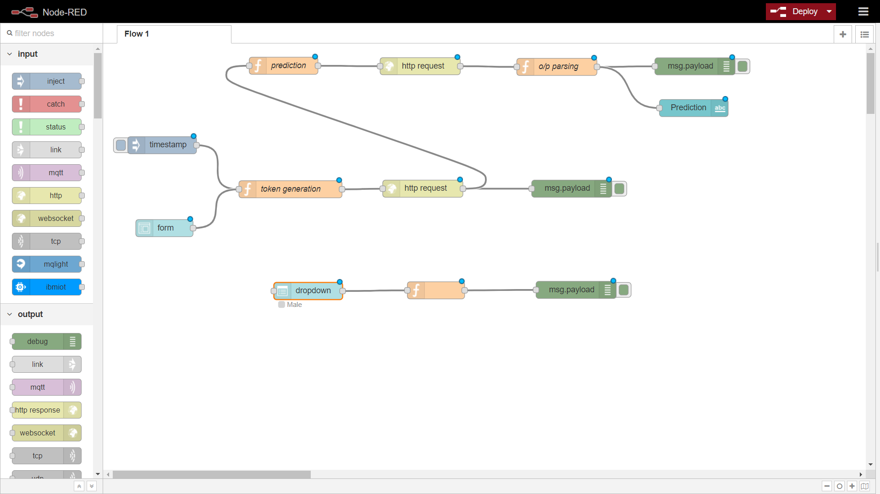
NODE RED FLOW

Slide 11
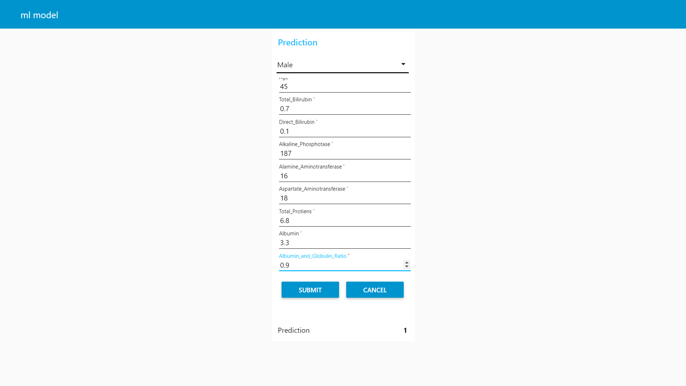
USER INTERFACE USING IBM WATSON SERVICE

Slide 12
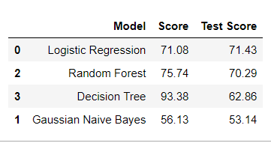
CONCLUSION
Initially, the dataset was explored and made ready to be fed into the classifiers. This was achieved by removing some rows containing null values, transforming some columns which were showing skewness and using appropriate methods (one-hot encoding) to convert the labels so that they can be useful for classification purposes.

